Slide 1

FPT University
Android programMing
Lesson 25
Version 1.0

Slide 2
Agenda
Gradle in Android

Slide 3
Overview of Gradle
Gradle is an automated build toolkit that allows the way in which projects are built to be configured and managed through a set of build configuration files. This includes defining how a project is to be built, what ependencies need to be fulfilled for the project to build successfully and what the end result of the build process should be

Slide 4
Overview of Gradle
Gradle and Android Studio Gradle brings a number of powerful features to building Android application projects. Some of the key features are as follows:
Sensible Defaults Dependencies Build Variants | Manifest Entries APK Signing ProGuard Support

Slide 5
Overview of Gradle
Sensible Defaults Gradle implements a concept referred to as convention over configuration. This simply means that Gradle has a pre-defined set of sensible default configuration settings that will be used unless they are overridden by settings in the build files

Slide 6
Overview of Gradle
Dependencies If a module within an Android Studio project which triggers an intent to load another module in the project. The first module has, in effect, a dependency on the second module since the application will fail to build if the second module cannot be located and launched at runtime.

Slide 7
Overview of Gradle
Build Variants Gradle also provides build variant support for Android Studio projects. This allows multiple variations of an application to be built from a single project. Android runs on many different devices encompassing a range of processor types and screen sizes. In order to target as wide a range of device types and sizes as possible it will often be necessary to build a number of different variants of an application

Slide 8
Overview of Gradle
Manifest Entries Each Android Studio project has associated with it an AndroidManifest.xml file containing configuration details about the application. A number of manifest entries can be specified in Gradle build files which are then auto-generated into the manifest file when the project is built

Slide 9
Overview of Gradle
APK Signing It is also possible to include the signing information entered through the Android Studio user interface within a Gradle build file so that signed APK files can be generated from the command-line.

Slide 10
Overview of Gradle
ProGuard Support ProGuard is a tool included with Android Studio that optimizes, shrinks and obfuscates Java byte code to make it more efficient and harder to reverse engineer (the method by which the logic of an application can be identified by others through analysis of the compiled Java byte code). The Gradle build files provide the ability to control whether or not ProGuard is run on your application when it is built.

Slide 11
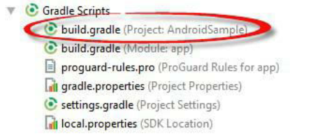
Overview of Gradle
The Top-level Gradle Build File
Each project contains one top-level Gradle build file. This file is listed as build.gradle (Project:<project name>) and can be found in the project tool window

Slide 12
Overview of Gradle
By default, the contents of the top level Gradle build file read as follows:
// Top-level build file where you can add configuration options common to all sub-projects/modules. buildscript { repositories { google() jcenter() } dependencies { classpath 'com.android.tools.build:gradle:3.2.1' // NOTE: Do not place your application dependencies here; they belong // in the individual module build.gradle files } } allprojects { repositories { google() jcenter() } } task clean(type: Delete) { delete rootProject.buildDir }

Slide 13
Overview of Gradle
Module Level Gradle Build Files An Android Studio application project is made up of one or more modules. Take, for example, a hypothetical application project named GradleDemo which contains two modules named Module1 and Module2 respectively. In this scenario, each of the modules will require its own Gradle build file. In terms of the project structure, these would be located as follows: · Module1/build.gradle · Module2/build.gradle

Slide 14
Overview of Gradle
By default, the Module1 build.gradle file would resemble that of the following listing:
apply plugin: 'com.android.application' android { compileSdkVersion 28 defaultConfig { applicationId "com.example.fpt.gradlebuildexample" minSdkVersion 26 targetSdkVersion 28 versionCode 1 versionName "1.0" testInstrumentationRunner "android.support.test.runner.AndroidJUnitRunner" } buildTypes { release { minifyEnabled false proguardFiles getDefaultProguardFile('proguard-android.txt'), 'proguard-rules.pro' } } } dependencies { implementation fileTree(dir: 'libs', include: ['*.jar']) implementation 'com.android.support:appcompat-v7:28.0.0' implementation 'com.android.support.constraint:constraint-layout:1.1.3' testImplementation 'junit:junit:4.12' androidTestImplementation 'com.android.support.test:runner:1.0.2' androidTestImplementation 'com.android.support.test.espresso:espresso-core:3.0.2' }

Slide 15
Overview of Gradle
Configuring Signing Settings in the Build File The settings of signingSettings may also declare in build.gradle(Project level) file.
signingConfigs { release { storeFile file("keystore.release") storePassword "your keystore password here" keyAlias "your key alias here" keyPassword "your key password here" } }

Slide 16
Gradle Build Variants Example
The goal of this chapter is to use the build variants feature of Android Studio to create a project which can be built in two flavors designed to target phone and tablet devices respectively. The build environment will be configured such that each flavor can be built using either a release or debug build type. The end result, therefore, will be four build variant options available for selection within Android Studio: · phoneDebug · phoneRelease · tabletDebug · tabletRelease

Slide 17
Gradle Build Variants Example
Creating the Build Variant Example Project Let’s create any project for example

Slide 18
Gradle Build Variants Example
Adding the Build Flavors to the Module Build File
apply plugin: 'com.android.application' android { ......
flavorDimensions "version" productFlavors { phone {
dimension "version" applicationId "com.example.fpt.gradlebuildexample.app.phone" versionName "1.0-phone" } tablet {
dimension "version" applicationId "com.example.fpt.gradlebuildexample.app.tablet" versionName "1.0-tablet" } } ...... }

Slide 19
Gradle Build Variants Example
Once the changes have been made, a yellow warning bar will appear across the top of the editor indicating that the changes to the Gradle build file need to be synchronized with the rest of the project. Click on the Sync Now link located in the warning panel to perform the synchronization.

Slide 20
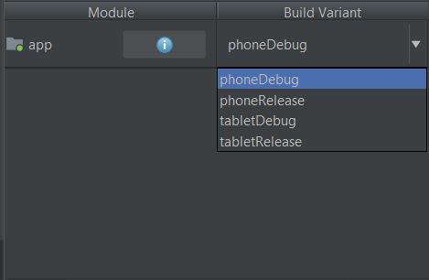
Gradle Build Variants Example
open the Build Variants tool window either using the quick access menu located in the status bar in the bottom left-hand corner of the Android Studio main window or using the Build Variant tool window bar. Once loaded, clicking in the Build Variant cell for the app module should now list the four build variants:

Slide 21
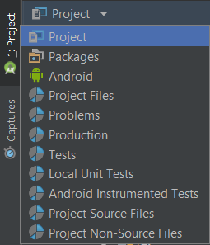
Gradle Build Variants Example
Adding the Flavors to the Project Structure
Switch the window into Project mode
Right-click on the BuildExample -> app -> src directory, select the New -> Directory menu option and create a new directory named phone/res/layout
Create more directory named phone/res/values
Do the same things with tablet folder

Slide 22
Gradle Build Variants Example
Adding Resource Files to the Flavors Each flavor is going to need to contain a copy of the activity’s activity_xxx_example.xml and strings.xml resource files. Each copy will then be modified to meet the requirements of the respective flavor. These files will need to be copied to the new build directory

Slide 23
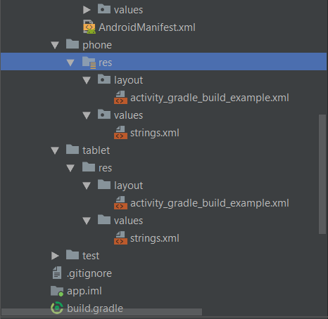
Gradle Build Variants Example
With the changes made, the flavor section of the project structure should look like this

Slide 24
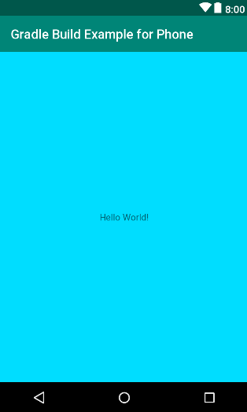
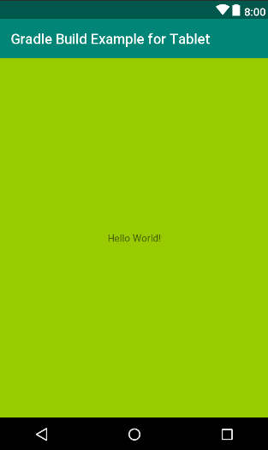
Gradle Build Variants Example
Customizing the Activity Classes

Slide 25
Gradle Build Variants Example
Build and test for each flavors

Slide 26

End of Lesson 25

Slide 27
Thank you!

